Slide 1
Snack Squad: ACustomizable Snack Ordering And Delivery App

Slide 2
MainActivity.kt
package com.example.snacksquad
import android.os.Bundle
import androidx.activity.viewModels
import androidx.appcompat.app.AppCompatActivity
import androidx.recyclerview.widget.LinearLayoutManager
import androidx.recyclerview.widget.RecyclerView
import com.example.snacksquad.database.Snack
import com.example.snacksquad.database.SnackViewModel
class MainActivity : AppCompatActivity()
{ private lateinit var snackViewModel: SnackViewModel private lateinit var snackRecyclerView:

Slide 3
private lateinit var snackAdapter: SnackAdapter
// Assume you have created a SnackAdapter for RecyclerView
override fun onCreate(savedInstanceState: Bundle?) {
super.onCreate(savedInstanceState)
setContentView(R.layout.activity_main)
// Initialize RecyclerView
snackRecyclerView = findViewById(R.id.snackRecyclerView)
snackRecyclerView.layoutManager = LinearLayoutManager(this)
snackAdapter = SnackAdapter() // Initialize your adapter
snackRecyclerView.adapter = snackAdapter
snackViewModel = SnackViewModel(application)

Slide 4
snackViewModel.allSnacks.observe(this, { snacks ->
// Update the cached copy of the snacks in the adapter
snacks?.let { snackAdapter.setSnacks(it) }
})
// Handle Place Order button click
findViewById<Button>(R.id.placeOrderButton).setOnClickListener {
// Logic to place an order (e.g., open an Order Activity)
}
}
}

Slide 5
Snack Adapter
class SnackAdapter :
RecyclerView.Adapter<SnackAdapter.SnackViewHolder>() {
private var snacks = emptyList<Snack>()
SnackViewHolder(itemView: View)RecyclerView.ViewHolder(itemView)
{
val snack Name: TextView = itemView.findViewById(R.id.snack_name)
val snackPrice: TextView = itemView.findView
} }

Slide 6
Activity main XML
<androidx.constraintlayout.widget.ConstraintLayout
xmlns:android="http://schemas.android.com/apk/res/android"
xmlns:app=http://schemas.android.com/apk/res-auto
xmlns:tools=http://schemas.android.com/tools
android:layout_width="match_parent"
android:layout_height="match_parent“
tools:context=".MainActivity">
android:id=“@+id/welcomeText” android:layout_width=“0dp” android:layout_height=“wrap_content

Slide 7
android:text="Welcome to Snack Squad!"
android:textSize="24sp"
android:textStyle="bold“
android:padding="16dp“
app:layout_constraintBottom_toTopOf="@+id/snackRecyclerView"
app:layout_constraintEnd_toEndOf="parent"
app:layout_constraintStart_toStartOf="parent"
app:layout_constraintTop_toTopOf="parent" />
<androidx.recyclerview.widget.RecyclerView android:id="@+id/snackRecyclerView" android:layout_width="0dp" android:layout_height=“0dp” app:layout_constraintBottom_toTopOf=“@+id/placeOrderButton

Slide 8
app:layout_constraintEnd_toEndOf="parent“
app:layout_constraintStart_toStartOf="parent“
app:layout_constraintTop_toBottomOf="@+id/welcomeText“
android:padding="8dp"/>
<!-- Button to place an order -->
<Button
android:id="@+id/placeOrderButton"
android:layout_width="wrap_content“
android:layout_height="wrap_content"
android:text="Place Order"

Slide 9
android:layout_margin="16dp"
app:layout_constraintBottom_toBottomOf="parent"
app:layout_constraintEnd_toEndOf="parent"
app:layout_constraintStart_toStartOf="parent" />
</androidx.constraintlayout.widgetConstraintLayout>

Slide 10
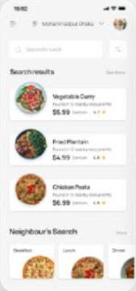
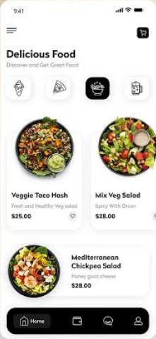
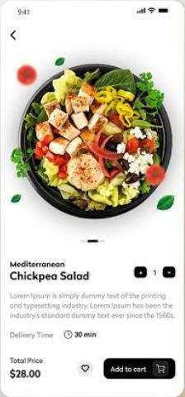
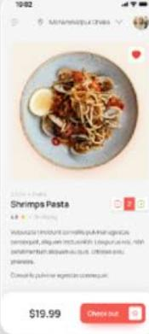
Output

